Slide 1
Generics, Lists, Interfaces
.NET Generic Collections

Slide 2
.NET Collections and Generics
A look back

Slide 3
.NET Collection Classes
C# has been through several versions since its inception around 2002
The first version had a set of Collection classes that represented various data structures
They were collections of System.Object
Since every class derives from System.Object, any item could be stored in an object of one of these classes
A collection object could hold an int, a String, an Employee, a Student, a TV, a Bus, and a Bulldozer object at the same time
Easy to add things, but tedious to retrieve/use them because what we retrieved was a System.Object, and not a Student, int, String, TV, Bus, or a Bulldozer
Casting and related coding techniques were necessary to use the items

Slide 4
.NET Generic Collection Classes
Beginning with version 2, .NET and C# have supported generic collection classes
A generic class is not an actual class but a blueprint or template from which many concrete classes can be generated
It has a complete class definition except that it uses one or more placeholders (called parameterized types) representing unspecified types
When it is time to use the generic class template to create an actual class, real types are substituted for the placeholders
Continued on the next slide

Slide 5
.NET Generic Collection Classes
One may create many actual classes from a generic class by substituting different actual data types for the placeholders
For example, if Group<type> is a generic collection class with one “placeholder” type, one may create actual classes from it by substituting actual types for the placeholder
Group <Student>
Group <Employee>
Group <String>
Group <FigNewton>
Objects of the resulting concrete classes may only hold object references of the designated types (and their subtypes, if any)

Slide 6

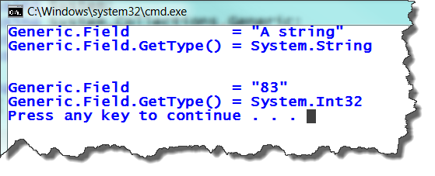
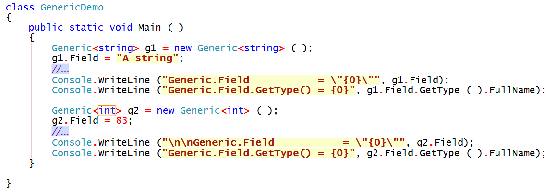
Very Simple Example
T is the placeholder or parameterized type
The parameterized type can be used in the body like any actual type
Substitution of actual type
Substitution of different actual type

Slide 7
.NET’s Generic Collections
Found in .NET’s System.Collections.Generic namespace
Contains implementations of generic versions of many different data structures that we will learn to use this semester including
Lists
Stacks
Queues
Linked Lists
more

Slide 8
List<T>
Generic array-like collection class

Slide 9
List<T>
C# has an ArrayList class, an object of which may contain references to System.Object items
C#’s generic List<T> is analogous to Java’s ArrayList<T>
Similar to an array in many ways
May use subscript to access an item unlike in Java
List<T> may grow/shrink over time as the needs of the program change
When adding an item to the List<T> object, its internal array, managed by the List<T> class itself, will grow if necessary to accommodate the new item

Slide 10
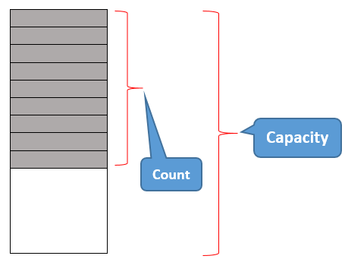
Count and Capacity of List<T>
The readonly Count property of List<T> tells how many values are currently in the List<T>
The Capacity of List<T> tells how many total positions are available in List<T> without it having to grow
This number includes those that are filled currently plus those where new items can be added without the List<T> having to grow
Capacity ≥ Count always

Slide 11
Constructors for List<T>
Name | Description
List <T>( ) | Initializes a new instance of the List <T> class that is empty and has the default initial capacity of 0
List <T> (IEnumerable <T>) | Initializes a new instance of the List <T> class that contains elements copied from the specified collection (the parameter) and has sufficient capacity to accommodate the number of elements copied
List <T> (Int32) | Initializes a new instance of the List <T> class that is empty and has the specified initial capacity
See “Help” in Visual Studio for details of all methods in the List<T> class

Slide 12
Methods
Name | Description
Add | Adds an object to the end of the List <T> .
AddRange | Adds the elements of the specified collection to the end of the List <T> .
AsReadOnly | Returns a read-only IList <T> wrapper for the current collection.
BinarySearch(T) | Searches the entire sorted List <T> for an element using the default comparer and returns the zero-based index of the element.
BinarySearch (T, IComparer <T> ) | Searches the entire sorted List <T> for an element using the specified comparer and returns the zero-based index of the element.
BinarySearch (Int32, Int32, T, IComparer <T>) | Searches a range of elements in the sorted List <T> for an element using the specified comparer and returns the zero-based index of the element.

Slide 13
Methods
Clear | Removes all elements - makes the list empty
Contains | Determines whether an element is in the List <T>.
ConvertAll <TOutput > | Converts the elements in the current List <T> to another type, and returns a list containing the converted elements.
CopyTo ( array<T> ) | Copies the entire List <T> to a compatible one-dimensional array of T, starting at the beginning of the target array.
CopyTo ( array<T> , Int32) | Copies the entire List <T> to a compatible one-dimensional array, starting at the specified index of the target array.
CopyTo (Int32, array<T>, Int32, Int32) | Copies a range of elements from the List <T> to a compatible one-dimensional array, starting at the specified index of the target array.
Equals(Object) | Determines whether the specified Object is equal to the current Object. (Inherited from Object.)
Exists | Determines whether the List <T> contains elements that match the conditions defined by the specified predicate.

Slide 14
Methods
Find | Searches for an element that matches the conditions defined by the specified predicate, and returns the first occurrence within the entire List <T> .
FindAll | Retrieves all the elements that match the conditions defined by the specified predicate.
FindIndex (Predicate <T>) | Searches for an element that matches the conditions defined by the specified predicate, and returns the zero-based index of the first occurrence within the entire List <T> .
FindIndex (Int32, Predicate <T>) | Searches for an element that matches the conditions defined by the specified predicate, and returns the zero-based index of the first occurrence within the range of elements in the List <T> that extends from the specified index to the last element.

Slide 15
Methods
FindLast | Searches for an element that matches the conditions defined by the specified predicate, and returns the last occurrence in the List <T>.
FindLastIndex (Predicate <T>) | Searches for an element that matches conditions defined by the specified predicate, and returns zero-based index of last occurrence within entire List <T>.
FindLastIndex (Int32, Predicate <T>) | Searches for an element that matches the conditions defined by the specified predicate, and returns the zero-based index of the last occurrence within the range of elements in the List <T> that extends from the first element to the specified index.
FindLastIndex (Int32, Int32, Predicate <T>) | Searches for an element that matches the conditions defined by the specified predicate, and returns the zero-based index of the last occurrence within the range of elements in the List <T> that contains the specified number of elements and ends at the specified index.
ForEach | Performs specified action on each element of List <T>.

Slide 16
Methods
GetRange | Creates a shallow copy of a range of elements in the source List <T>.
GetType | Gets the Type of the current instance. (Inherited from Object.)
IndexOf (T) | Searches for the specified object and returns the zero-based index of the first occurrence within the entire List <T>.
IndexOf (T, Int32) | Searches for the specified object and returns the zero-based index of the first occurrence within the range of elements in the List <T> that extends from the specified index to last element.
IndexOf (T, Int32, Int32) | Searches for the specified object and returns the zero-based index of the first occurrence within the range of elements in the List <T> that starts at the specified index and contains the specified number of elements.
Insert | Inserts an element into the List <T> at the specified index.
InsertRange | Inserts the elements of a collection into the List <T> at the specified index.

Slide 17
Methods
LastIndexOf(T) | Searches for specified object and returns the zero-based index of the last occurrence within the entire List <T>.
LastIndexOf(T, Int32) | Searches for the specified object and returns the zero-based index of the last occurrence within the range of elements in the List <T> that extends from the first element to the specified index.
LastIndexOf(T, Int32, Int32) | Searches for the specified object and returns the zero-based index of the last occurrence within the range of elements in the List <T> that contains the specified number of elements and ends at the specified index.

Slide 18
Methods
Remove | Removes first occurrence of specific object from List <T>.
RemoveAll | Removes all the elements that match the conditions defined by the specified predicate.
RemoveAt | Removes element at the specified index of the List <T>.
RemoveRange | Removes a range of elements from the List <T>.
Reverse ( ) | Reverses order of the elements in the entire List <T>.
Reverse(Int32, Int32) | Reverses order of the elements in the specified range.
Sort ( ) | Sorts the elements in the entire List <T> using the default comparer.
Sort(Comparison <T>) | Sorts the elements in the entire List <T> using the specified System ..::. Comparison <T>.
Sort(IComparer <T>) | Sorts the elements in the entire List <T> using the specified comparer.
Sort(Int32, Int32, IComparer <T>) | Sorts the elements in range of elements in List <T> using the specified comparer.

Slide 19
Methods
ToArray | Copies the elements of the List <T> to a new array.
ToString | Returns a String that represents the current Object. (Inherited from Object.)
TrimExcess | Sets the capacity to the actual number of elements in the List <T>, if that number is less than a threshold value.
TrueForAll | Determines whether every element in the List <T> matches the conditions defined by the specified predicate.

Slide 20
Properties
Name | Description
Capacity | Gets or sets the total number of elements the internal data structure can hold without resizing.
Count | Gets the number of elements actually contained in the List <T>.
Item | Gets or sets the element at the specified index.

Slide 21
Limitations and Restrictions
Comparers are required for full functionality

Slide 22
Limitations and Restrictions
The List <T> class uses both an equality comparer and an ordering comparer
Equality comparers are used when we must determine whether a given value is in the list or whether a value in the list is equal to a specified value
Ordering comparers are used when one must rearrange the values in the list into a particular order
We must be able to decide whether one item is “smaller”, “equal to”, or “larger” than another item
We must decide what “smaller” and “larger” mean

Slide 23
Equality Comparer
Methods such as Contains, IndexOf, LastIndexOf, and Remove use an equality comparer for the list elements to determine whether two values of type T are “equal”
The default equality comparer for type T is determined as follows.
If type T implements the IEquatable <T> generic interface, then the equality comparer is the Equals(T) method of that interface
Otherwise, the default equality comparer is Object.Equals(Object)

Slide 24
Equality Comparer
List<T> methods that search for a match, must have code similar to the following:
if ( myList [index].Equals (SearchTarget) )
// take action if item matches target
In order for this to work, there MUST be a method named Equals in the class T that compares an element (from the List) of type T against a parameter (SearchTarget) of type T

Slide 25
Limitations and Restrictions
Methods such as BinarySearch and Sort use an ordering comparer for the list elements
The default comparer for type T is determined as follows
If type T implements the IComparable <T> generic interface, then the default comparer is the CompareTo(T) method of that interface
Otherwise, if type T implements the nongeneric IComparable interface, then the default comparer is the CompareTo(Object) method of that interface
If type T implements neither interface, then there is no default comparer, and a comparer or comparison delegate must be provided explicitly

Slide 26
IComparable <User>
Sort must determine whether user1 > user2, user1 < user2, or user1 == user2 to find out if an exchange is needed
The Sort method contains code that does something like this
if (user1.CompareTo(user2) < 0)
{
//... code to handle case that user1 < user2
}
else if (user1.CompareTo (user2) > 0)
{
//... code to handle case that user1 > user2
}
else
{
//... code to handle case that user1 == user2
}
This requires a method with the following signature in the User class
public int CompareTo (User user2)

Slide 27
Other Limitations and Restrictions
The List <T> is not guaranteed to be sorted
You must sort the List <T> before performing operations (such as BinarySearch) that require the List <T> to be sorted
Elements in this collection can be accessed using an integer index
Indexes in this collection are zero-based
List <T> accepts null (a null reference) as a valid value for reference types
List <T> allows duplicate elements – that is, the same value may appear in the List<T> more than once

Slide 28
The IEquatable<T> Interface
Implementing the IEquatable<T> interface assures that data of type T can be compared for equality
T t1, t2;
if ( t1.Equals(t2) ) …
If you implement IEquatable <T>, you should also override the base class implementations of Object.Equals(Object) and GetHashCode so that their behavior is consistent with that of the IEquatable<T>.Equals method
If you do override Object.Equals(Object) , your overridden implementation is also invoked in calls to the static Equals(System.Object, System.Object) method on your class
This ensures that all invocations of the Equals method return consistent results

Slide 29
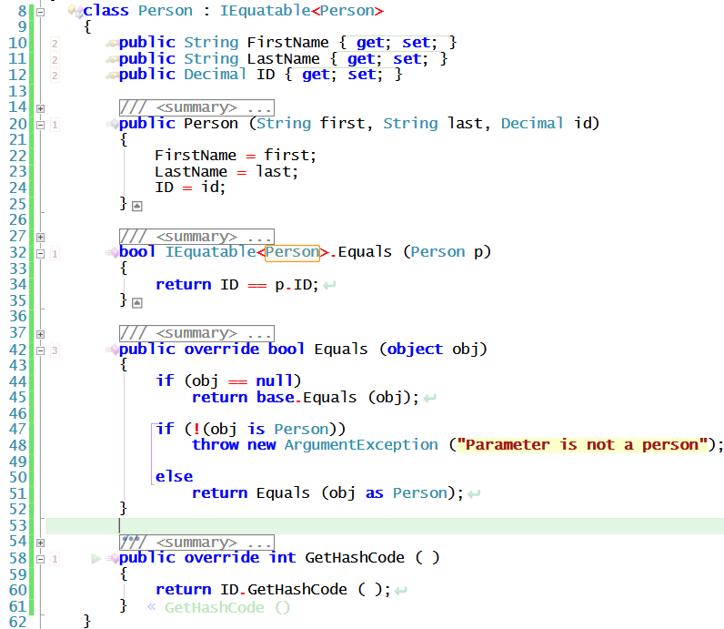
Partial IEquatable<T> Example
IEquatable<T>.Equals
Compares 2 Persons
Override of Object.Equals
Compares Person to any object
Uses IEquatable<T> version
Override of Object.GetHashCode

Slide 30
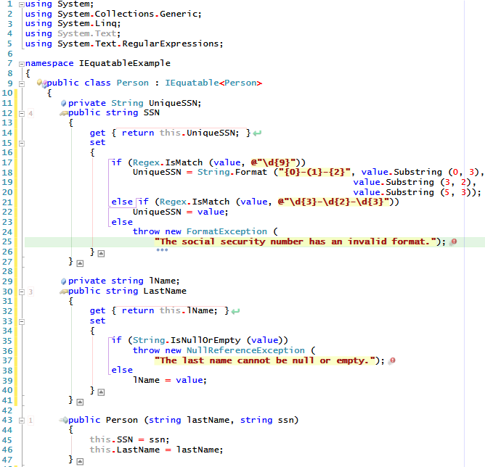
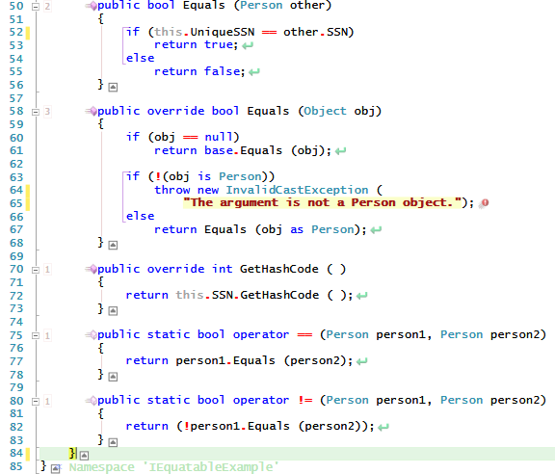
Full Example

Slide 31
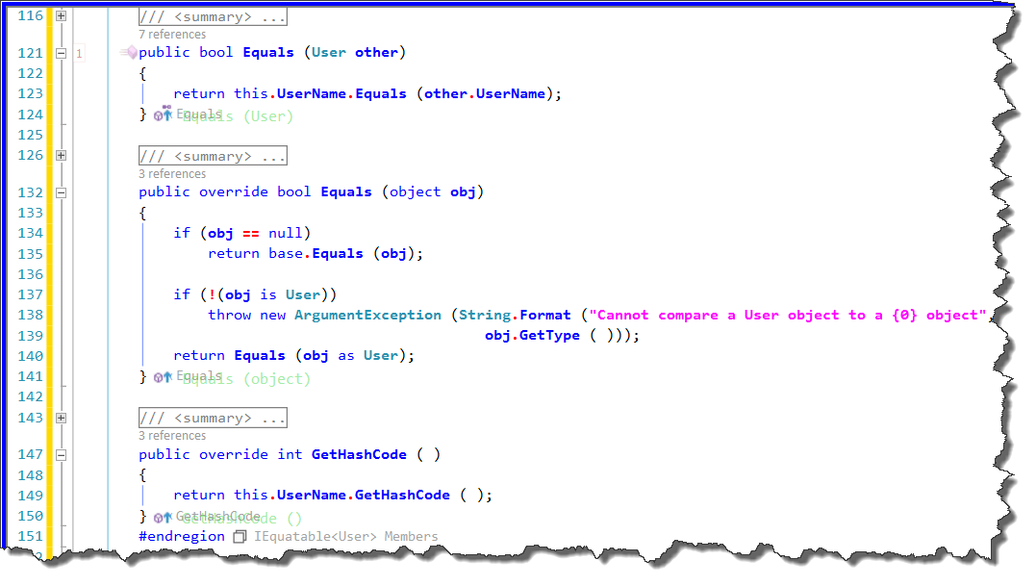
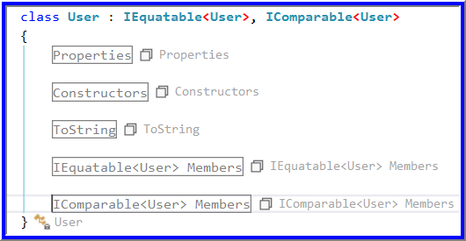
IEquatable <User> Implementation
Compare two Users
Compare User to any object
If Users are equal, their hash codes should be equal, too

Slide 32
The IComparable<T> Interface
Some methods of the List<T> class require that we be able to compare 2 items of type T to determine their order
Examples include the following methods
Sort
BinarySearch
T must implement the IComparable <T> interface
T must implement a CompareTo <T> method to compare two items of type T

Slide 33
CompareTo <T>
The CompareTo <T> method has the following header line
public int CompareTo <T> (T item)
The method returns an integer whose sign is the crucial element of the result
For two items X and Y of type T
X.CompareTo (Y) returns 0 if X == Y
X.CompareTo (Y) < 0 if X < Y
X.CompareTo (Y) > 0 if X > Y
Where all comparisons of X and Y follow type T’s rules

Slide 34
Rules CompareTo Must Follow
A CompareTo <T> implementation must follow a set of common-sense rules
The rules are listed on the next slide

Slide 35
Rules for CompareTo<T>
For objects A, B, and C of type T these must be true:
A.CompareTo (A) must return zero (i.e., A == A)
If A.CompareTo(B) returns zero, then B.CompareTo (A) must return zero (i.e., if A==B, then B==A)
If A.CompareTo(B) returns zero and B.CompareTo (C) returns zero, then A.CompareTo (C) must return zero (if A==B and B==C, then A==C)
If A.CompareTo (B) returns a value other than zero, then B.CompareTo (A) must return a value of the opposite sign (i.e., A > B ➔ B < A and A < B ➔ B > A)
If A.CompareTo (B) returns a value x that is not equal to zero, and B.CompareTo (C) returns a value y of the same sign as x, then A.CompareTo (C) must return a value of the same sign as x and y ( A < B and B < C ➔ A < C; same for >)

Slide 36
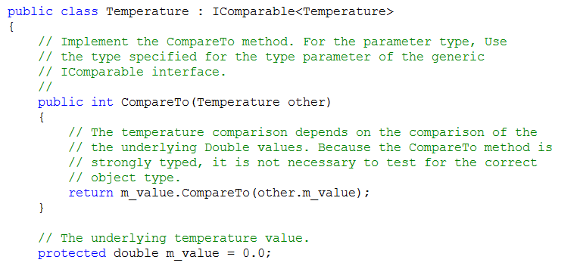
Partial Example of IComparable<T>
CompareTo<T> method

Slide 37
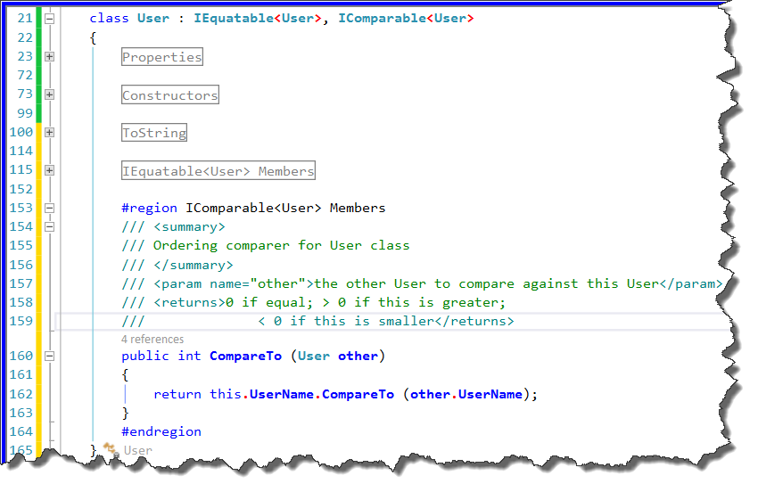
IComparable<User> Implementation

Slide 38
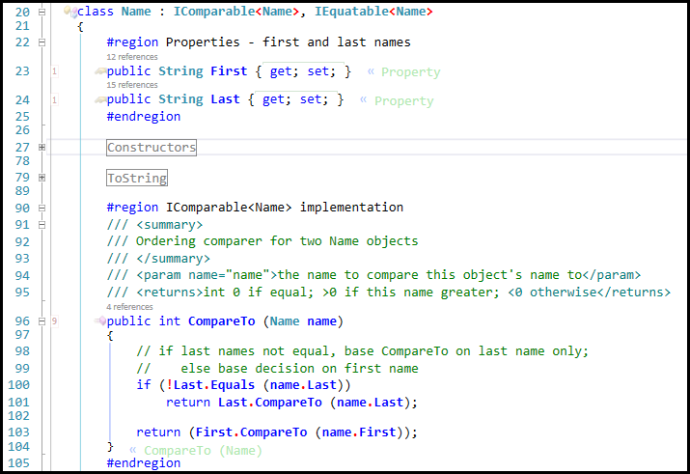
IComparable<T> Example
Continued on next slide →
Compare two Name objects to decide on their order

Slide 39
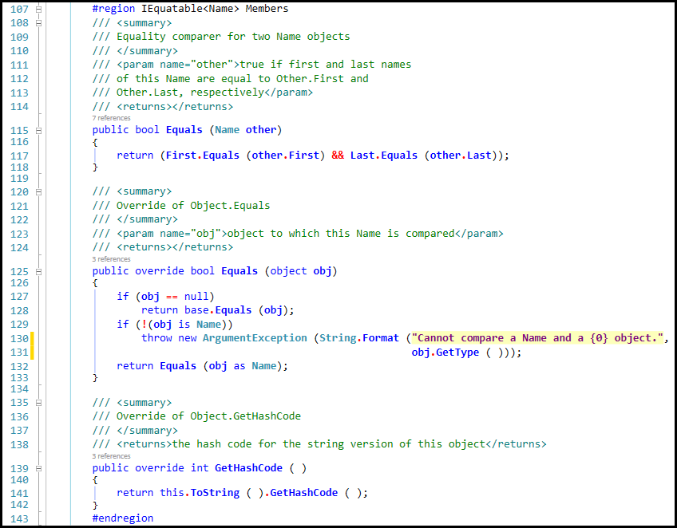
Example – IEquatable<T> continued
Compare two Name objects for equality
Override methods from System.Object so they do same thing as Equals<T> above

Slide 40
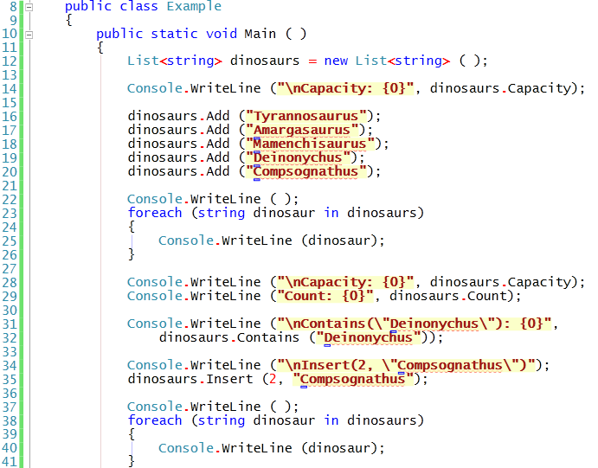
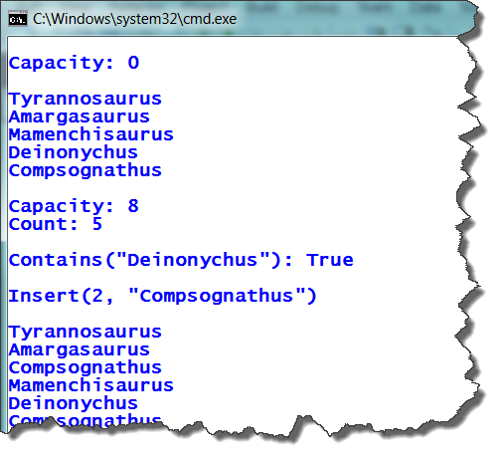
Example
Output
IEquality<T>

Slide 41
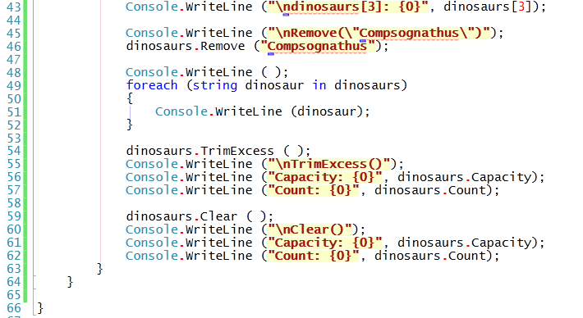
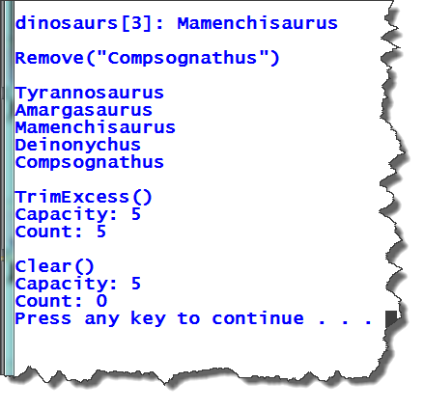
Example (continued)
Uses IEquality<T>
Output

